Slide 1

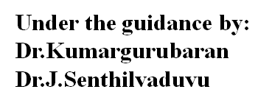
3D Geospatial Visualization for Urban and Environmental Data
Presented By:
K. Jahnavi(192424242)
M. Lakshmi Sahithi(192424280)
C. Sai Harshitha(192424346)

Slide 2
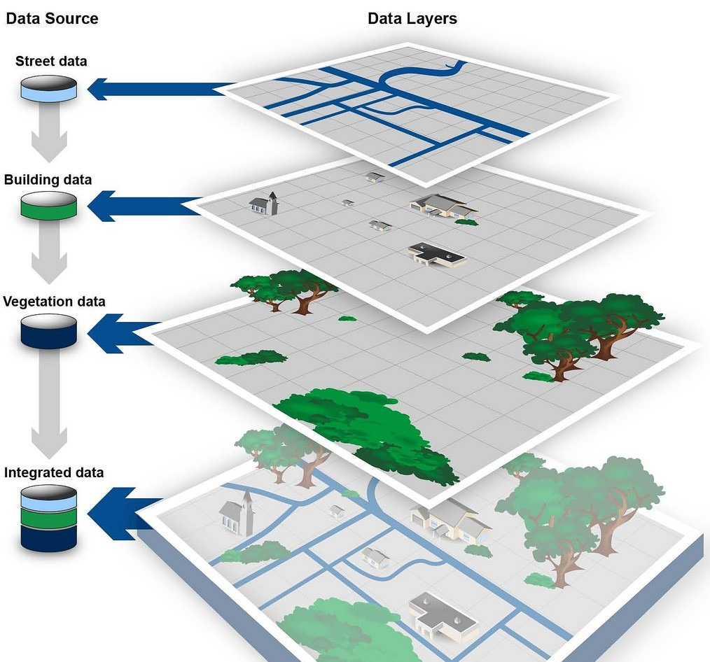
INTRODUCTION
3D geospatial visualization represents spatial data in a realistic three-dimensional form.
It helps in better understanding of urban and environmental structures.
Traditional 2D maps have limitations in showing height and depth information.
Integrating GIS and remote sensing improves spatial data analysis.
This approach supports effective urban planning and environmental management.

Slide 3
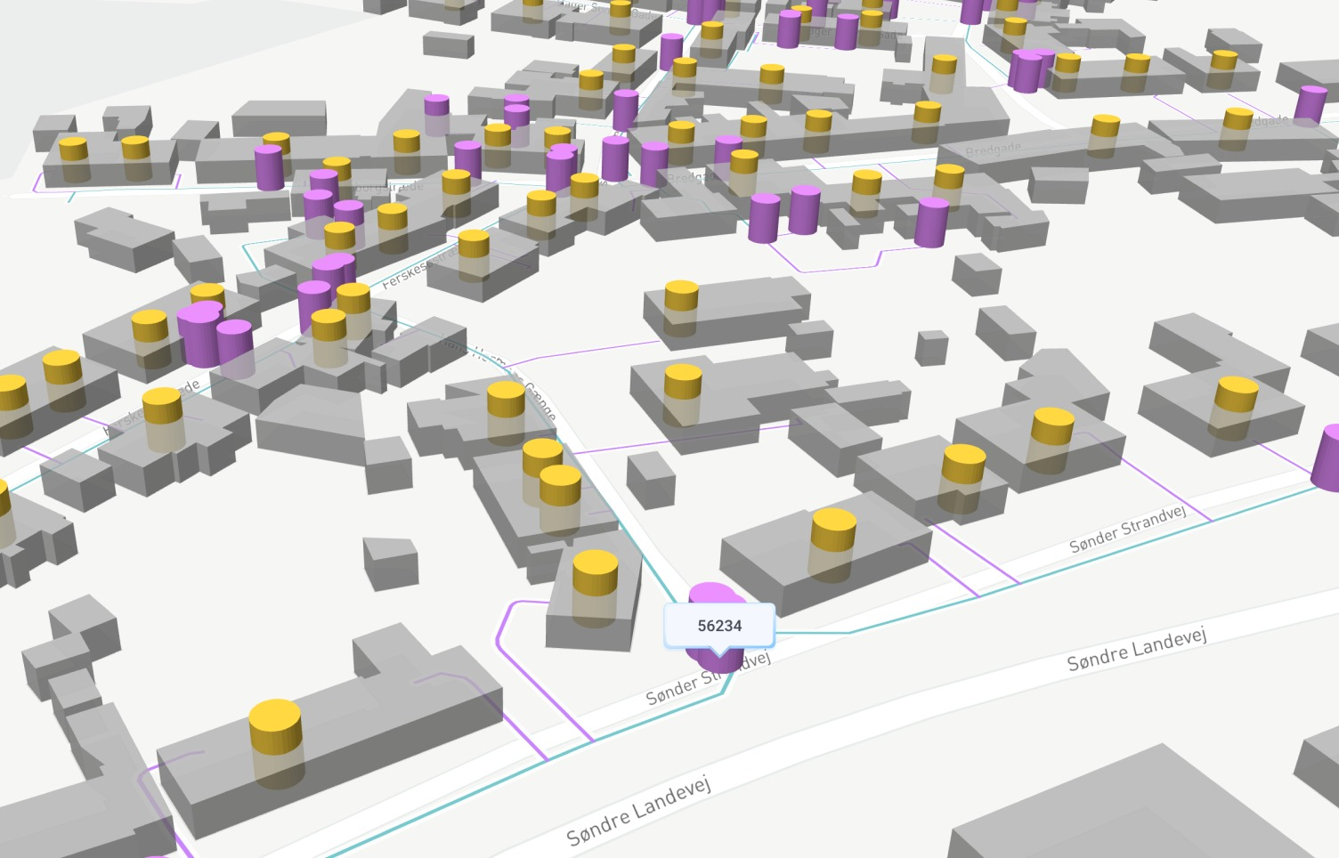
ABSTRACT
Represents urban and environmental data using realistic 3D geospatial models.
Helps analyze complex spatial patterns like land use and urban growth.
Integrates GIS, remote sensing, and real-time data sources.
Supports effective decision-making in urban planning and environmental management.
Improves data understanding, accuracy, and visual clarity.

Slide 4
PROBLEM STATEMENT
Urban and environmental data are often not integrated for combined analysis.
Environmental conditions vary across locations and are hard to visualize spatially.
Most tools rely on static 2D maps, limiting spatial understanding.
Integrating real-time environmental data with urban context is challenging.
There is a need for an interactive 3D geospatial visualization system for better analysis and decisions.

Slide 5
OBJECTIVES
To collect and preprocess urban and environmental geospatial data.
To develop an interactive 2D and 3D visualization system.
To visualize urban structures and environmental parameters effectively.
To enable comparative analysis across multiple geographic locations.
To support decision-making through intuitive visual insights.

Slide 6
DATASET
Urban Reference Dataset:
Cities and towns with latitude and longitude.
Source: Compiled reference dataset (validated using OpenStreetMap coordinates).
Environmental Dataset (Real-Time):
Air Quality, Temperature, Humidity, Wind Speed.
Source: Open-Meteo public APIs.
Visualization Data:
2D maps and 3D interactive models.
Source: Leaflet and Plotly libraries in R.

Slide 7
METHODOLOGY
Data Collection:
Urban reference data and real-time environmental data are gathered from datasets and public APIs.
Data Preprocessing:
Coordinates are validated and environmental values are prepared for visualization.
User Interaction:
Locations are selected through an interactive map interface.
3D Visualization:
Urban and environmental data are displayed using interactive 3D models.
Analysis and Insights:
Visual comparisons are used to support decision-making.

Slide 8
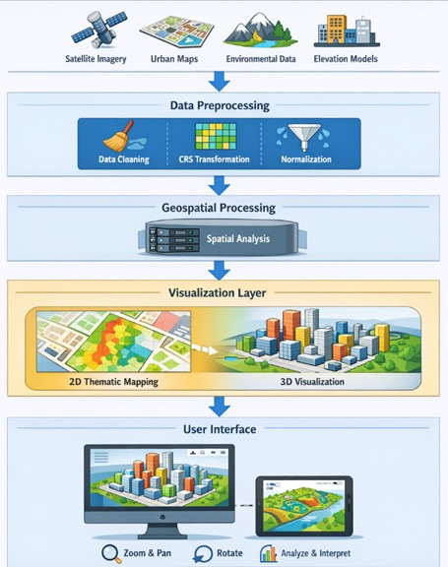
ARCHITECTURE

Slide 9
MODULE 1
Collect and Preprocess Geospatial Urban and Environmental Data
Collects urban reference data
Collects real-time environmental data (AQI, Temperature, Humidity, Wind Speed)
Performs preprocessing:
  coordinate validation
  nearest-city mapping
  data cleaning and scaling
Technologies involved:
Open- Meteo APIs
Excel dataset
R (data preprocessing functions)

Slide 10
MODULE 2
Build Interactive 3D Models and Visualizations
Interactive 2D map for selecting geographic locations
Real-time update of visualizations based on user interaction
Abstract 3D urban modeling using:
Grey 3D building blocks
Green cover patches
Water body patches
Layer-based visualization for better clarity and comparison
Zooming, rotation, and panning of 3D models

Slide 11
Libraries Used:
Shiny – To build the interactive web-based application
Leaflet – For 2D geospatial mapping and location selection
Plotly – For interactive 3D visualizations and models
ggplot2 – For generating supporting analytical graphs
jsonlite – To parse real-time data from web APIs
readxl – To load and process urban reference datasets

Slide 12
MODULE 3
Analyze Data and Generate Decision-Support Insights
Aggregation of environmental data from multiple user-selected locations
Visual comparison of AQI levels to assess pollution severity
Evaluation of temperature and wind speed trends across regions
Assessment of humidity distribution for climatic understanding
Identification of spatial differences in environmental conditions
Analytical Visualizations Used:
Bar Charts – AQI and Humidity comparison
Dot Plots – Temperature and Wind Speed variation

Slide 13
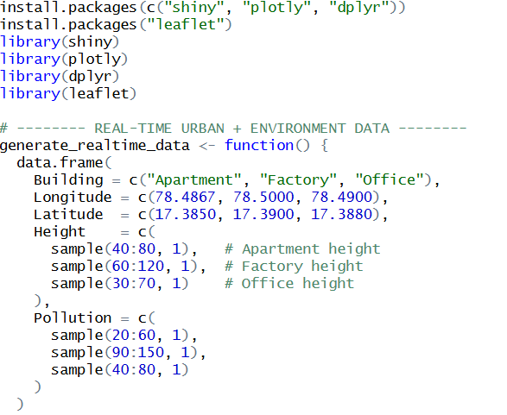
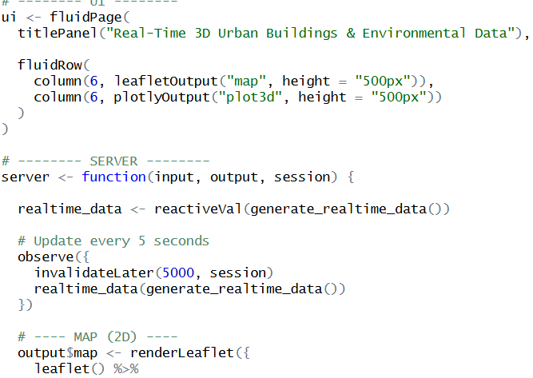
IMPLIMENTATION:

Slide 14
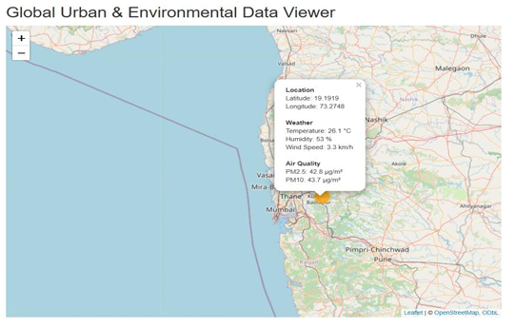
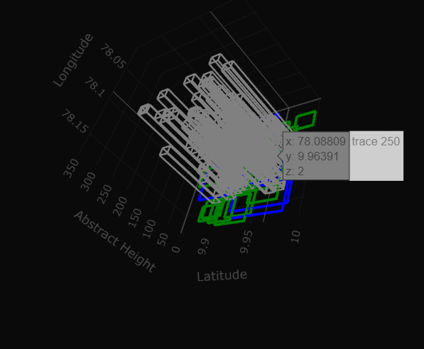
OUTPUT:

Slide 15
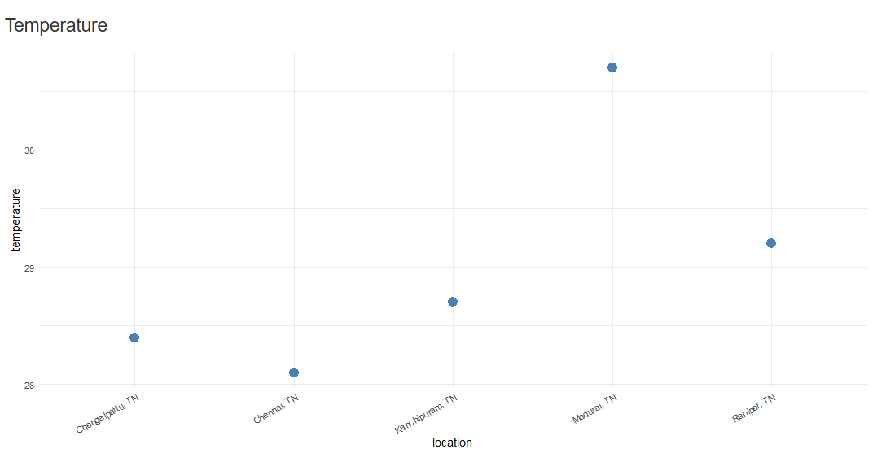
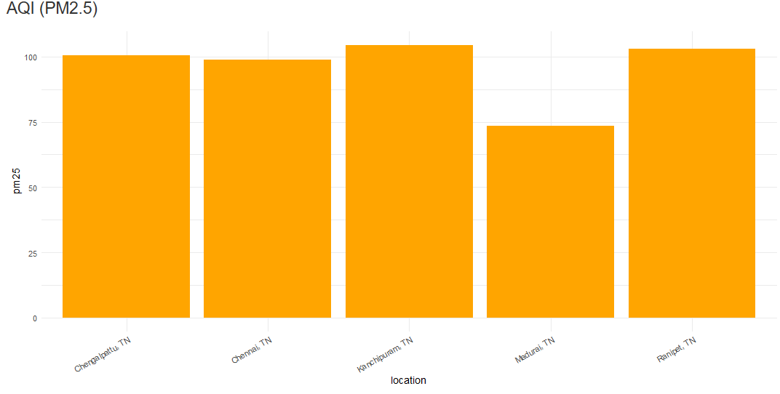
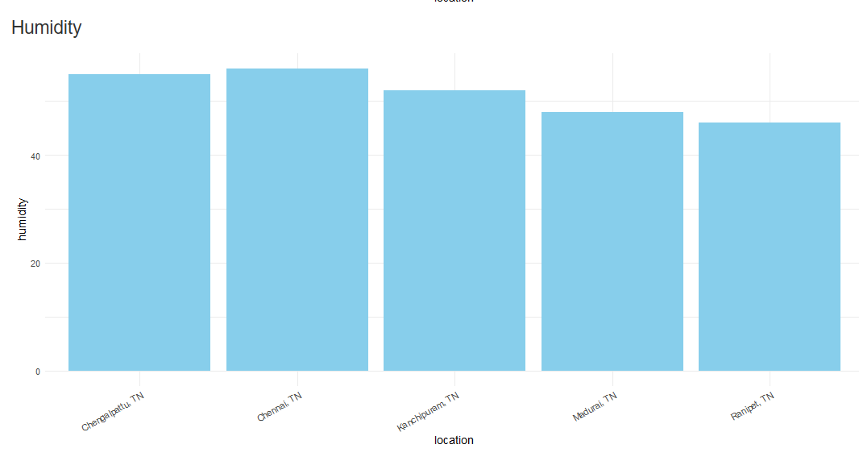
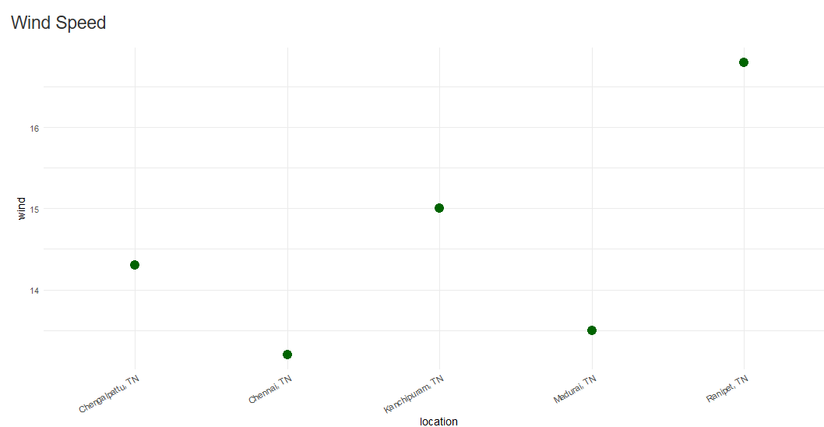
OUTPUT:

Slide 16
CONCLUSION
3D geospatial visualization effectively represents complex urban and environmental data.
It improves understanding of spatial relationships compared to traditional 2D maps.
Integration of multiple geospatial data sources enhances analysis accuracy.
The system supports better urban planning and environmental decision-making.
Overall, 3D visualization provides clearer insights and more informed solutions.

Slide 17
References
Biljecki, F. et al. (2022). 3D city models for urban and environmental analysis. ISPRS Journal.
Liu, X., & Zhang, Y. (2023). 3D geospatial visualization techniques in urban planning. Computers, Environment and Urban Systems.
La Guardia, M. et al. (2024). Real-time 3D geospatial data integration for smart cities. ISPRS Archives.
Somanath, S. et al. (2024). Urban digital twins using 3D geospatial data. Remote Sensing.
Lei, B., & Biljecki, F. (2025). Advances in open 3D city models. ISPRS Annals.

Slide 18
FUTURE SCOPE
Integration of real-time IoT and sensor data for live urban monitoring.
Use of AI and machine learning to predict urban growth and environmental changes.
Development of digital twins for smart city planning and simulation.
Enhanced VR and AR-based 3D visualization for immersive analysis.
Cloud-based platforms for large-scale data sharing and collaborative decision-making.

Slide 19
THANK YOU

